Slide 1
Network Security

Slide 2
Overview
Content
  Introduction
  Firewall (FW)
  Intrusion Detection System (IDS)
  SSL/TLS
After this module, you should be able to
  Describe what network firewall is and its applications
  Describe what intrusion detection system is and its applications
  Describe the SSL/TLS workflow

Slide 3


Communication between computers
Host A
Host B
App A
App A
App B
App B
Subnet 2
Subnet 1
Router
Link Level
Internet
Non Examinable.

Slide 4
IP Packets or Datagram
Internet Protocol (IP) Address
  4 bytes or 32 bits, usually in dot decimal notation, used by network interfaces.
  e.g., 203.116.221.170
Most IP addresses are publicly accessible in the Internet. Some are for private addresses, i.e., they cannot be directly reached in the Internet, e.g., the SMU IP address assigned to your computer.
Ports:
  two bytes or 16 bits, used by applications within one device.
  There are two types of ports: TCP ports and UDP ports. The uses of them follow different protocols
Internet communications are in the form of a stream of packets which usually specify four addresses: source IP, destination IP, source port and destination port
Src IP Adr; Des IP Adr Src Port#; Des Port# Payload
IP header
TCP/UDP header
Notes:
Payload is Application Payload like body, json etc. Header etc.

Slide 5
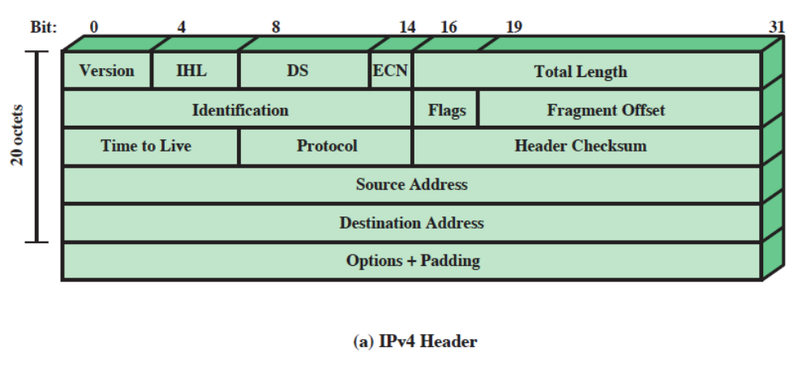
IPv4 Header
IP Address
Notes:
Firewall will determine the rule based on information in identification, protocol, version, ihl etc.

Slide 6
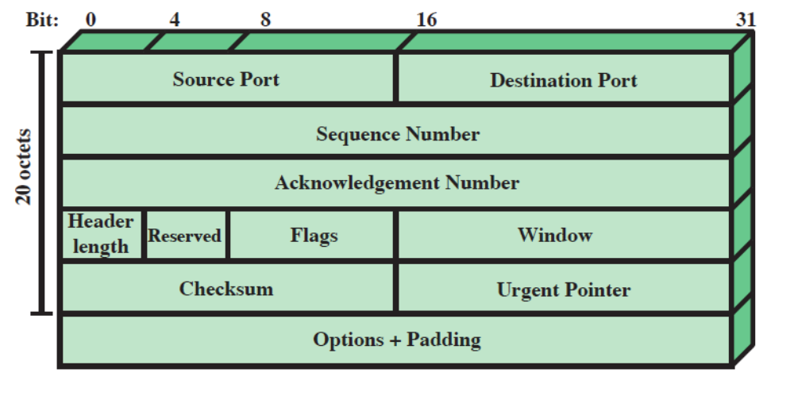
TCP Header
Port Address
TCP ports: FTP(20 & 21), SSH(22), TELNET(23), SMTP(25), HTTP(80), HTTPS(443)

Slide 7
Exercise
Launch a terminal in MAC or a DOS command window in Windows
Mac users: run “ifconfig”
Windows users: run “ipconfig”
Find your laptop’s MAC address and its IP address (if any)

Slide 8



FW vs IDS
Intrusion Detection Systems (IDS)
Firewall (FW)
catch me if you can
Notes:
Firewall is intrusion prevention.
Firewall blocks things like Google, block access to other countries lottery sites.

Slide 9

Firewall
https://www.youtube.com/watch?v=kDEX1HXybrU
Notes:
Safety barrier between private network and public network.
Public network may try to penetrate.
Host based firewall – installed on host (computer, only host)
Network based firewall - router controls.

Slide 10
Network Firewall
Internal network
External network
Firewall
Main functions: by filtering and auditing traffic between internal and external network
  Prevent unauthorized access to a private network and unauthorized outgoing traffic.
  Traffic volume/speed regulation.
Deployed at the network boundary, the exit/entrance point.
Notes:
Filtering traffic from outside. Prevent malicious access of the private network and unauthorized going traffic.

Slide 11
Firewall categorization
Policy: open policy vs close policy
Functioning level: IP filter vs Application gateway
Position: network based vs host based
functioning layer
policy
application
close
network
open
host
network
position
Notes:
Policy – Open means everything is allowed except those that’s blocked.
Close means everything is not allowed except those that’s allowed.
If lets say packets from a source, 2 is ok, last is not ok from firewall rule, then it will not success.
Close policy – better for security, open is more common.
Functioning layer – At network layer, they filter things like IP addresses and via ports.
Look at metadata.
Application gateway – filter based on application data like payload.
Look at the body like payload, Header etc.
Position – Protection of whole network OR protection of host only.

Slide 12
Close Policy
Only whitelisted packets are forwarded:
Firewall-filter (packet p)
{
  if (allow(p))
  forward(p);
  else
  drop(p);
  }
boolean allow(packet p)
{
if (p is from NUS)
return true;
if (p is from .gov)
return true;
if (p is a ping packet)
return true;
return false;
}
1. NUS
2. .gov
3. ping
…
Whitelist

Slide 13
Open Policy
Only blacklisted packets are dropped:
boolean deny(packet p)
{
if (p is a ping packet)
return true;
if (p is from NTU)
return true;
if (p is from .org)
return true;
return false;
}
  Firewall (packet p)
  {
  if (deny(p))
  drop(p);
  else
  forward(p);
  }
1. ping
2. NTU
3. .org
…
Blacklist

Slide 14
FW’s functioning layer
IP layer: Packet filtering gateway
  make decision based on individual packet
  examine packet headers (i.e., metadata) only
Application layer: a.k.a. Application proxy gateway (bastion host), Guard
  inspect the contents of communication by simulating the effect of the application.
weak;
low cost;
strong;
high cost;
Notes:
Packet filtering – examine packet headers.
Application layer – examine the body of the requests cos you need to check the content.

Slide 15





Limitations of FW
Internal network
Firewall
External network
Single Point of Failure
Performance bottleneck
Notes:
single point of failure
You only have 1 way to protect your network, if this fails, your entire network will probably fail
If firewall is compromised, it will spoil whole network.
Bottleneck because since it is checking application layer, it will take up some time during the querying.

Slide 16

Intrusion Detection System (IDS)
Main Function: inspect network traffic within a network to detect attacks
An ideal IDS should notify security manager of an ongoing attack
  100% accuracy
  In real time manner
  Complete diagnosis
  Effective recommendations on how to react
Notes:
Real time, 100% accuracy, Complete Diagnosis and recommendation
You need to detect if the person is an intruder or legit person.
Firewall– work based on rules so that can block traffic to certain servers.

Slide 17




Signature-Based vs Anomaly-Based
GET /default.ida?NNNNNNNNNNNNNNNNNNNNNNNNN NNNNNNNNNNNNNNNNNNNNNNNNNNNNNNNNNNNN NNNNNNNNNNNNNNNNNNNNNNNNNNNNNNNNNNNN NNNNNNNNNNNNNNNNNNNNNNNNNNNNNNNNNNNN NNNNNNNNNNNNNNNNNNNNNNNNNNNNNNNNNNNN NNNNNNNNNNNNNNNNNNNNNNNNNNNNNNNNNNNN NNNNNNNNNNNNNNNNNNN %u9090%u6858%ucbd3%u7801%u9090%u6858%ucbd3%u7801 %u9090%u6858%ucbd3%u7801%u9090%u9090%u8190%u00c3 %u0003%u8b00%u531b%u53ff%u0078%u0000%u00=a HTTP/1.0
Signature based IDS
basic idea: to match network traffic with pre-defined attack patterns (i.e., signatures).
e.g., signature of code red worm.
Anomaly based IDS
Profile: model of normal behaviors
IDS reports situations that deviates from profiles
basic idea: IDS has been trained to differentiate normal traffic and abnormal traffic, by using machine learning techs.
Notes:
The “signature” here has nothing to do with “digital signatures”.
Signature based – you have a database with past pre-defined attack patterns (signatures) – basically, you know what is bad already and from there, everything that comes in if flagged. – there will be some buffer overflow. There will be some form of patterns coming out.
for(pattern of patterns){
if(patterns.isBad()){
//correct
}
}
Anomaly based– Instead of finding, you define a normal. If there is something that is not within the bound, then it will flag out. Something that does not match the normal model.

Slide 18
Accuracy
Both signature-based IDS and Anomaly-based IDS are not 100% accurate in the following sense:
If IDS raises an alarm, is it indeed an attack?
If IDS does not raise an alarm, is it indeed benign?
If no, this is called a false alarm or false positive; otherwise, called true alarm or true positive.
If no, this is called a false negative or a miss; otherwise, called true negative or a catch
 | Is an attack | Is not an attack
Identified as an attack | True Positive (TP) | False Positive (FP)
Identified as not an attack | False Negative (FN) | True Negative (TN)

Slide 19
Accuracy
Both signature-based IDS and Anomaly-based IDS are not 100% accurate in the following sense:
If IDS raises an alarm, is it indeed an attack?
If IDS does not raise an alarm, is it indeed benign?
If no, this is called a false alarm or false positive; otherwise, called true alarm or true positive.
If no, this is called a false negative or a miss; otherwise, called true negative or a catch
Typical IDS
IDS with no false positive
IDS with no false negative
Benign
Attack
Benign
Attack
Benign
Attack
IDS alarms
IDS alarms
IDS alarms
low miss rate
Benign
Attack
IDS alarms
low false positive rate
Ideal IDS!!

Slide 20
Accuracy Evaluation of IDS
False negative (miss) rate (FNR) = fn / (tp + fn) | Recall = tp / (tp + fn) – which part of true positive is actually positive.
False discovery rate (FDR) = fp / (tp + fp) | Precision = tp / (tp + fp)
False positive (alarm) rate (FPR) = fp / (fp + tn) | Specificity = tn / (fp + tn)
Accuracy = tp + tn / (tp + tn + fp + fn)
Recall & FNR
FPR & Specificity
 | Is an attack | Is not an attack
Identified as an attack | True positive (TP) | False positive (FP)
Identified as not an attack | False Negative (FN) | True Negative (TN)
FDR & Precision
Notes:
Recall – how many real attacks you caught (Of all real attacks, how many did I detect?)
True attack / true attack + false negative attacks
Precision – how accurate the attacks are (Of all alerts I raised, how many were actually attacks?)
True attack / all attacks (true attack + false positive attacks)
Specificity – how well you ignored normal traffic (Of all normal cases, how many did I correctly not flag?)
Precision = tp / fp + tp
Odds for raising alarm for being positive/malicious = 999/1000 = 0.999
(recall)
Odds wrongly for raising an alarm for beign events = 1 / 100 (FPR)
fp/actual negatives
1 / 100 000 = malicious case
1 * 0.999 = chance of being true alarm = tp
99 999 (negative) * 1/100 = fp = chance of being false alarms

Slide 21
Accuracy Evaluation of IDS
Example: suppose an IDS monitored 1000 events. Among them 10 are real attacks. But, the IDS raised 20 alarms, among which 16 alarms are actually wrong. Compute the false positive rate and the recall.
Notes:
Real attacks are tp and fn.
Go and read and understand.

Slide 22
Analysis of False Discovery Rate
Example
  An IDS is 99% (0.99) accurate. e.g.,
    100 benign packets checked, 99 test negative
    100 malicious packet checked, 99 test positive
  Prevalence of malicious packet is 1 in 10,000
  Total positive results (total alerts):
    101=1 * 0.99 + 9,999 * (1-0.99)
  FDR: 9,999 * (1-0.99) in 101≅ 99%
  If the IDS raises an alarm on a packet, in 99% chance it is wrong!!
Good objects
Bad objects
9,999
1
99%
1%
false alarms
all alarms
Notes:
99% Accuracy but 1% Precision.
Precision =

Slide 23
Signature-Based vs Anomaly-Based
Signature based IDS
  Good: Low false alarm rates, instantaneous detection (practice)
  Bad: Cannot detect new attacks (a.k.a. 0-day attacks)
Anomaly based IDS
  Good: Can detect some new attacks
  Bad: High false alarm rates, high complexity (research)
  Get the help from recent machine learning techniques
Notes:
The “signature” here has nothing to do with “digital signatures”.
Low false alarm rates cos it is just a DB matching (kinda)
But bad is because if your DB don’t have that pattern, it will compromise.
Can detect abnormalies and can find abnormal network.
May have bad accuracy.
Usage of AI for anomaly based might be inaccurate, cause high false positive bad readings.

Slide 24
IDS Summary
Advantages
  Complement firewall
  Continues to improve
  Transparent installation
Disadvantages
  High false alarm rate
  May miss some new attacks
  Work after the fact
  Requires security personnel to handle alarms and monitor track records
Notes:
Not a single point of failure, both FW and IDS work together.
May have high rate of false predicts, may have single point of failure, and may not detect new attacks.

Slide 25
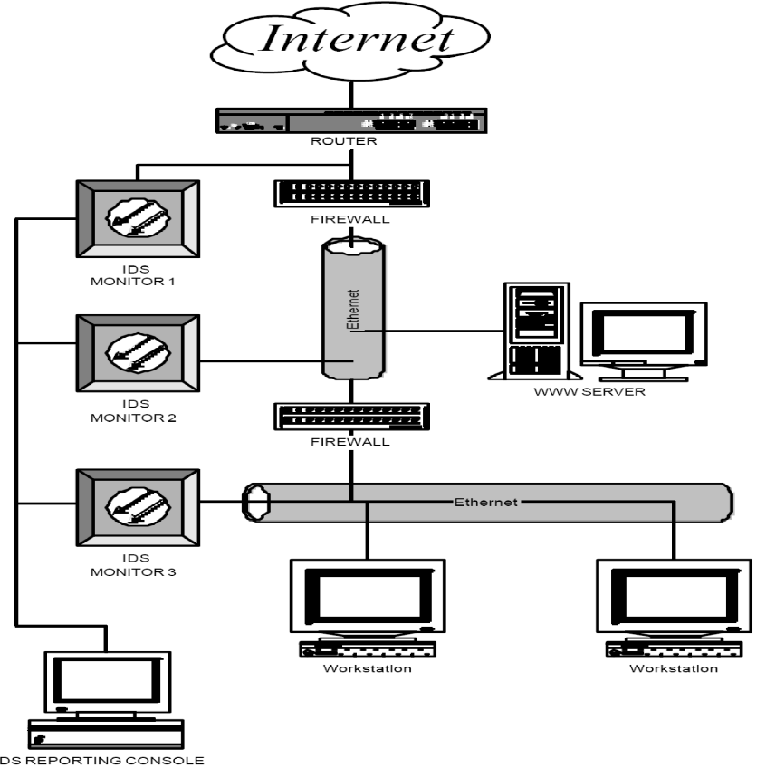
Deployment of FW and IDS
Firewall is always deployed at the perimeter of the protected facility (a network or a host).
  It must have the capability of intercepting network traffic.
  two firewalls create the DMZ (de-militarized zone) for network servers facing Internet traffic.
IDS is deployed side-by-side of the protected facility.
Notes:
Put it before the router.
Within router. But perimter.
Firewall between the ids?
IDS is the second layer of secuirty

Slide 26
Overview of SSL/TLS
SSL/TLS (Secure Socket Layer or Transport Layer Security) provides
  Implicit server authentication (because the server has a public key certificate)
  A secure channel between the server application and the client application (to encrypt/authenticate data sent in between).
SSL runs in two phases
  Handshake – estab sym key
  encryption and/or authentication – actual datas.
Notes:
In the real standard, SSL also supports client-end authentication. However, since most users do not have public key certificates, client-end authentication is not practical.
Firewall conducts filtering (payload or ip address/port).
How to protect data in transit? -> SSL and TLS is ususually used in confidentiality and integrity -> usually above transport layer, below application layer.
TCP and IP layer will do Ipsec -> filtering?

Slide 27
The Workflow
Client App
Server App
0. Request SSL connection
2. Establish connection
3. Send data (plaintext)
5. Receive data (plaintext)
1. SSL handshake session – cert verification
SSL
SSL
encryption & MAC gen
decryption & MAC vfy
4. Send encrypted and authenticated data
OS and libraries
OS and libraries

Slide 28






The Protocol of SSL/TLS handshake
Notes:
Cert does not ensure that person is the real server or not. Just show the keys belong to this person.
To know if the person is truly the real server, you need to test it to see if it knows the private key or not .

Slide 29
SSL/TLS Handshake (TLS 1.2 or earlier versions)
Server sends its public key certificate to the client. The cert contains Server’s public key (e.g. an RSA public key).
Client
  generate a random secret key k (e.g. an AES key)
  encrypt k with Server's public key
  send the ciphertext to Server.
Server decrypts the ciphertext to get k
Hereafter, Server and Client use k to protect their communications.
  encrypt messages using k for confidentiality.
  use HMAC with k to protect integrity

Slide 30
SSL/TLS Handshake (TLS 1.2 or earlier versions)
1.SSL Request
2.Server public key certificate
Web
client
Web server
3. A secret key is encrypted using Server’s public key
secure communication
(encryption and HMAC)
FYI: A key confirmation is also performed after step 3 to ensure both sides have the same AES key
Step 1~3 are called SSL handshake.

Slide 31
SSL Encryption
An SSL session is between two applications, not shared with any third one.
The security assurance of SSL hinges on the correct server certificate verification (Week 5).
  Using a wrong certificate leads to a connection to an impersonator.

